Slide 1
CS536: Data Communication & Computer Networks
Chunyi Peng
Spring 2023
Notes:
Syllabus

Slide 2
Agenda
Introduction
https://forms.gle/zqTYtvY6EdKz2o6J9
Syllabus: https://www.cs.purdue.edu/homes/chunyi/teaching/cs536-sp23/cs536-sp23.html
Brightspace
Campuswire: https://campuswire.com/c/GC1863205/

Slide 3
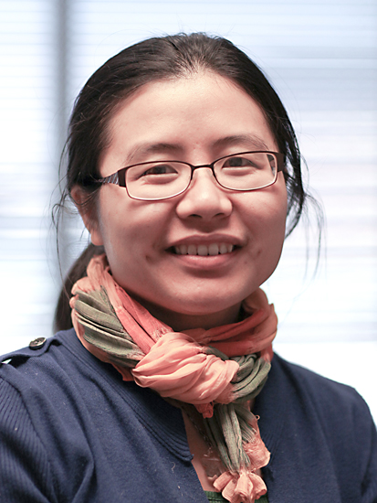
About Me
Chunyi Peng (https://www.cs.purdue.edu/homes/chunyi/)
2013, PhD, UCLA
2013 – 2017, Assitant Prof, Ohio State University
2017 – 2020, Assitant Prof, Purdue University
2020 – Present: Associate Professor
Research Areas:
Mobile networks (5G/6G)
AI for Network
5G/IoT security
Mobile edge computing (mainly for drones)
Office Hour: 11:00AM - 12:00PM, LWSN 2142E

Slide 4
About Three TAs
Junpeng Guo
Zizheng Liu
Chen Peng
Contact us: cs536-ta@cs.purdue.edu
PSOs and Office Hours (to be announced)
No PSOs in the first week
PSOs are optional but encouraged for homework, labs and exams
Check your PSO schedule and contact us if you have concerns on attending PSOs

Slide 5
About You
Attendee Survey: https://forms.gle/zqTYtvY6EdKz2o6J9
Your information
Why do you take this course?
What are your expectations with CS536?
What you know about computer networks (any prior experience)?
What else do you want to share about CS536?
…
Any other questions or concerns?
Notes:
Name
Department: CS or others?
PhD, MS, Undergrad (senior/junior)?
Research areas/interestes if applicable

Slide 6
In-Class Survey
Your department: CS and non-CS
Your program: PhD/MS/Undergrad
Why do you take this course?
To meet my core course requirement
Interest (no need to meet a core course requirement)
What is the minimal grade you need and expect?
A/A+ A- B+ B N/A

Slide 7
How much do you know about CS536?
Internet
TCP/IP
Application
transport
network
link
physical
Congestion
Control
End Hosts
Routing
Access Network
Core Network

Slide 8
BGP
SDN
MAC
Handover
WiFi 7
DASH
ARP
LEO
Edge Computing
Serverless Computing
Notes:
Serverless computing

Slide 9
What is your C programming level?
Never/rarely used
< 3 times (< 200 lines) used in my courses
>3 times or >500 lines used in my courses
Often used (beyond my course projects)

Slide 10
Why this survey?
Be interactive
Your feedback will be used to tune how to teach CS536 Scope: balance between Part I and Part II
Difficulty levels: from basic to advanced
Assignments: labs and homework
Quizzes and exams
Your feedback are welcome anytime

Slide 11
What is the course about?
Internet

Slide 12








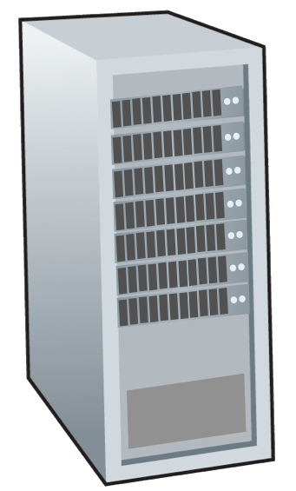
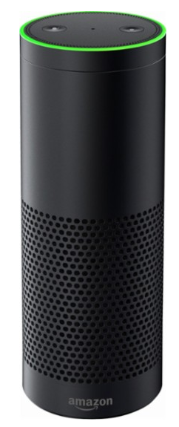
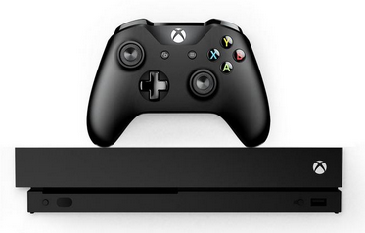
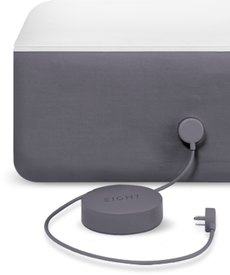
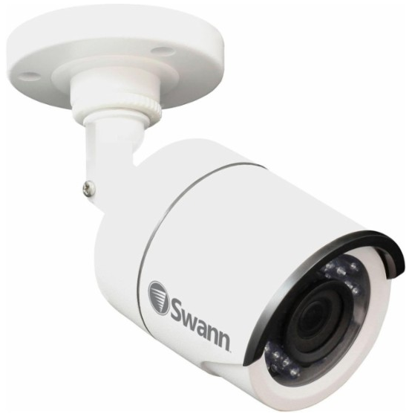
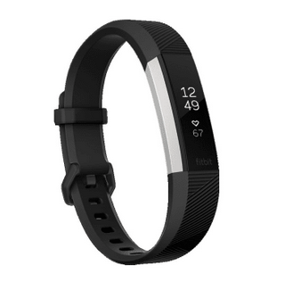
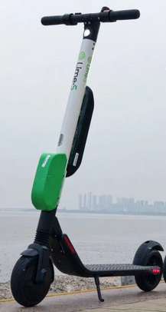

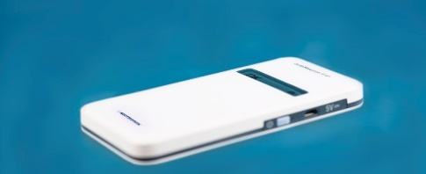
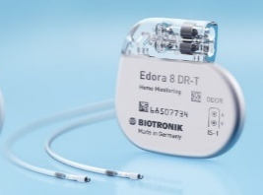
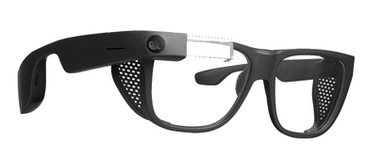

What is the course about?
Billions of connected computing devices (end systems/hosts)
Internet

Slide 13
What is the course about?
Billions of connected computing devices (end systems/hosts)
Access networks
(heterogenous)
Core network
(Internet backbone)
Internet

Slide 14
What is the course about?
Today’s Internet (basic)
A focus on TCP/IP protocols
Understand principles, concepts and main protocols
Develop basic network programming skills
Next-G Internet (advanced)
A focus on wireless and mobile networks
Topics: Internet of Things, AI for Net, edge computing …
Notes:
How does it work?

Slide 15

Textbook
James F. Kurose & Keith W. Ross, “Computer Networking: A Top Down Approach,” 8th edition,
Online lecture notes
Additional readings

Slide 16
Topics (tentative)
Today’s Internet (basic)
Chapter 1 – Chapter 6
Application → Transport → Networking → Link (Ethernet)
Next-G Internet (advanced)
Chapter 7, Chapter 8 and additional materials
Wireless networks → IoT, Edge computing → Security
Notes:
How does it work?

Slide 17
Grading Policy
Syllabus: https://www.cs.purdue.edu/homes/chunyi/teaching/cs536-sp23/cs536-sp23.html
Programming labs: 30%
Homework: 15%
Pop-up Quiz: 5%
Exams: 50%
Bonus Project : 10% (optional)

Slide 18
More Details
3 late days
3 programming labs in C (individual)
5-6 homework assignments
6 Quizzes (top-5 counted)
Midterm: 1 hour (20:00 PM - 21:00PM on Wed March 8th)
Final: 2 hours
Bonus (optional): a research project or a medium development project (much harder than any lab).

Slide 19
Another Perspective
Today’s Internet (basic): 70 – 80 %
2. Next-G Internet (advanced): 20 – 30 %
Two mechanisms
Basic/Easy parts with higher weights
Be curved
Notes:
How does it work?

Slide 20
Any Questions?
Please sign up Campuswire
https://campuswire.com/p/GC1863205
Code: 4178
Please finish attendee survey
https://forms.gle/zqTYtvY6EdKz2o6J9
Contact me right away if you have concerns/questions
Contact TAs and me: cs536-ta@cs.purdue.edu

